Slide 1
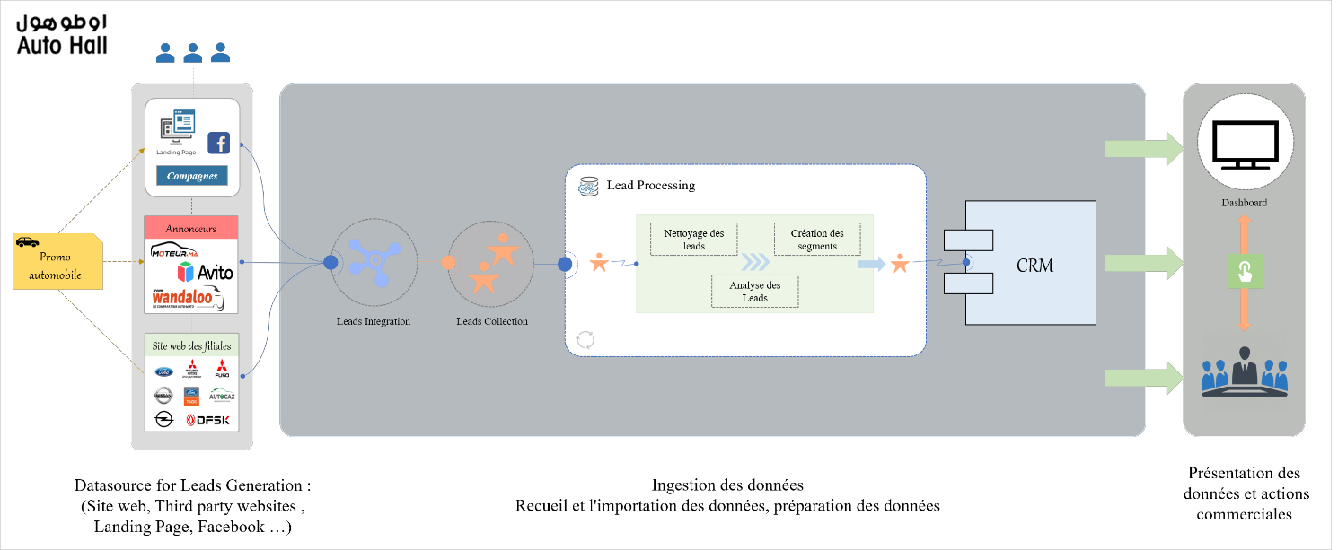

Slide 2
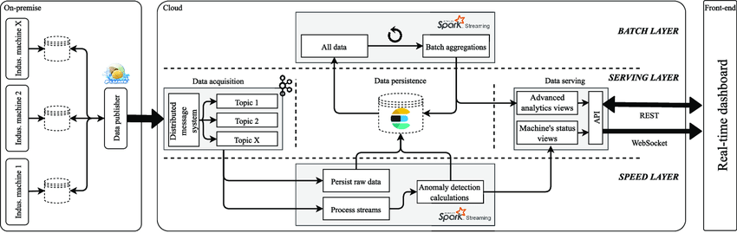

Slide 3
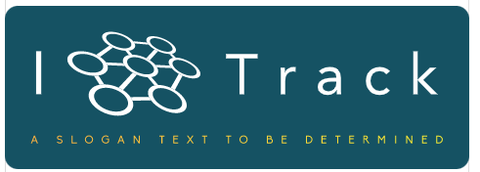
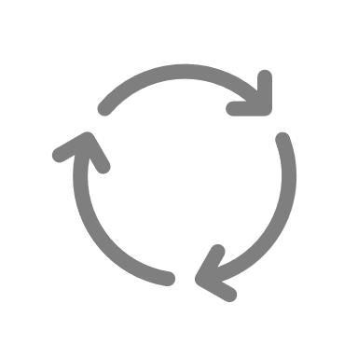

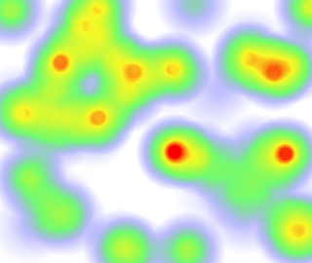
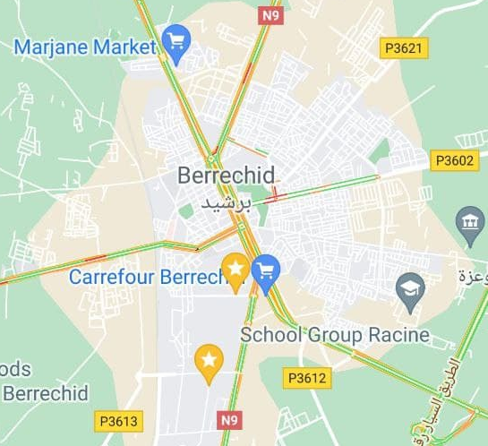

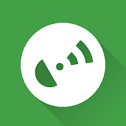


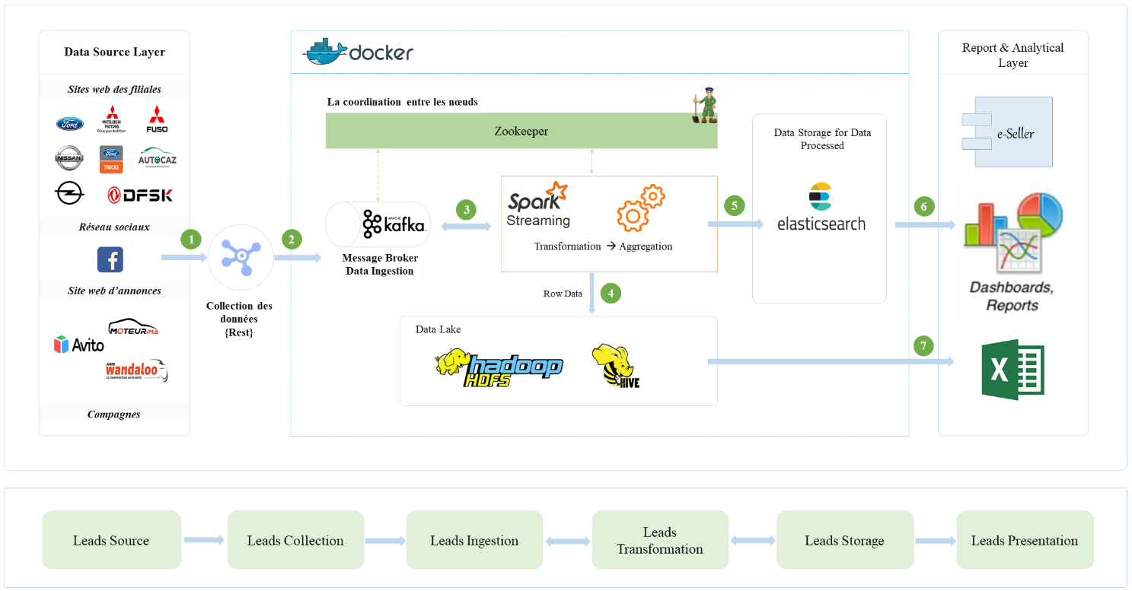
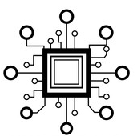

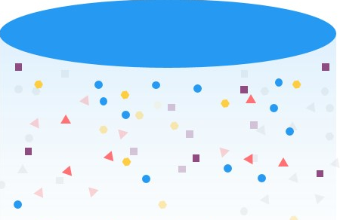
The main functional architecture of the project :
Data Source
Streams Processing
Data Reporting
Handle generated data in real time
Data Ingestion (Broker)
Serving Data
Data Processed
Data Server recipient
ETL Process
Heatmap
Advanced Computing
GPX Data Format
Advanced Analytics Algorithm
Data Lake – Long Term data Storage
Traccar application’s users
Persist Raw Data
Dashboard, Reports
ML Algorithm calculation

Slide 5
The main functional architecture of the project :
Data Source
Data Processing
Reporting
Data
Acquisition
Data Server recipient
Data Lake
Data Serving
Traccar application’s users

Slide 6
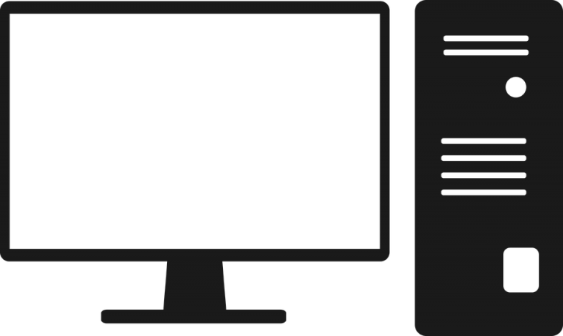
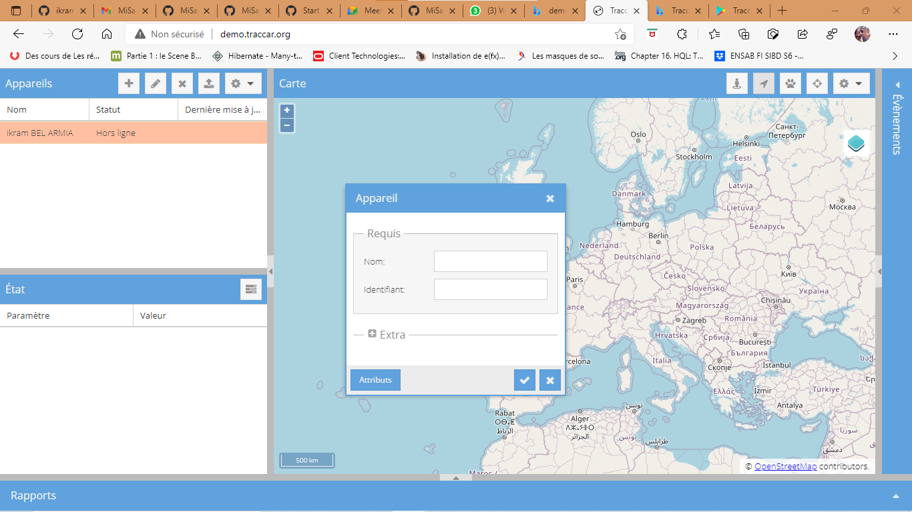



Project Subject
A group of people
Store the data generated by the group in the traccar sever
Determine the places visited by each person
Analyze the collected data
The Tracking can be done using traccar client application
Reporting

Slide 7
Progress Level
Traccar Client (Application)
Traccar Client is an application that allows you to use your mobile device as a GPS tracker. It reports location to your own or hosted server with selected time intervals.

Slide 8
To start using Traccar on your own system follow the steps below:
Download and install Traccar
Start Traccar service
Open web interface (http://localhost:8082, if connecting locally)
Log in as an administrator (default user - admin, password - admin) or register a new user
Add a new device with unique identifier
Configure your device to use appropriate address and port

Slide 9
To see your device on map you can register on
http://demo.traccar.org/
and add your device with identifier.

Slide 10


Current Step
Bind the application to the server
Traccar Client (Application)
Traccar Client (Server)

